Slide 1
Modeling and Data Uncertainties
This material is from the presentation:
Modeling and Data Uncertainties
Sankaran Mahadevan
Vanderbilt University, Nashville, TN
NASA/NAI Summer Design Institute on Uncertainty
Hampton, VA, July 20, 2011

Slide 4
Some concepts that we will cover
Least squares
Likelihood
Bayes theorem
MCMC simulation
Kernel density estimation
Sensitivity analysis
Surrogate modeling

Slide 5
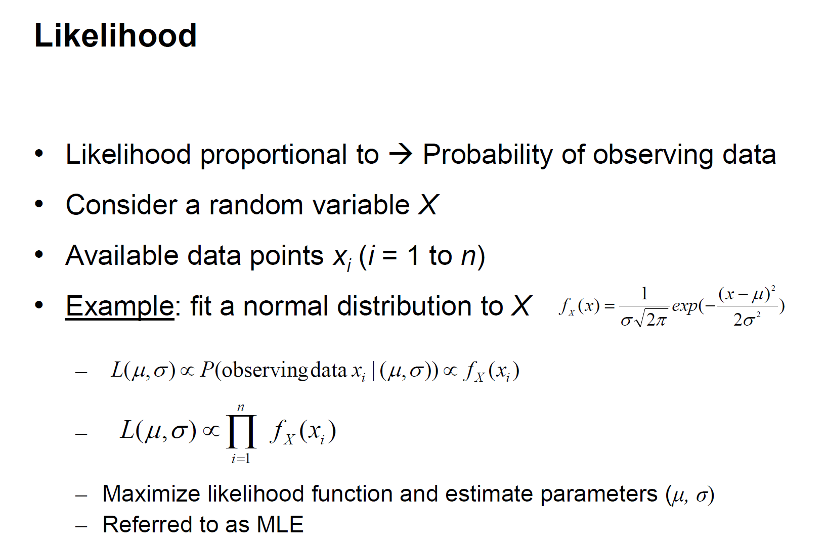

Slide 6
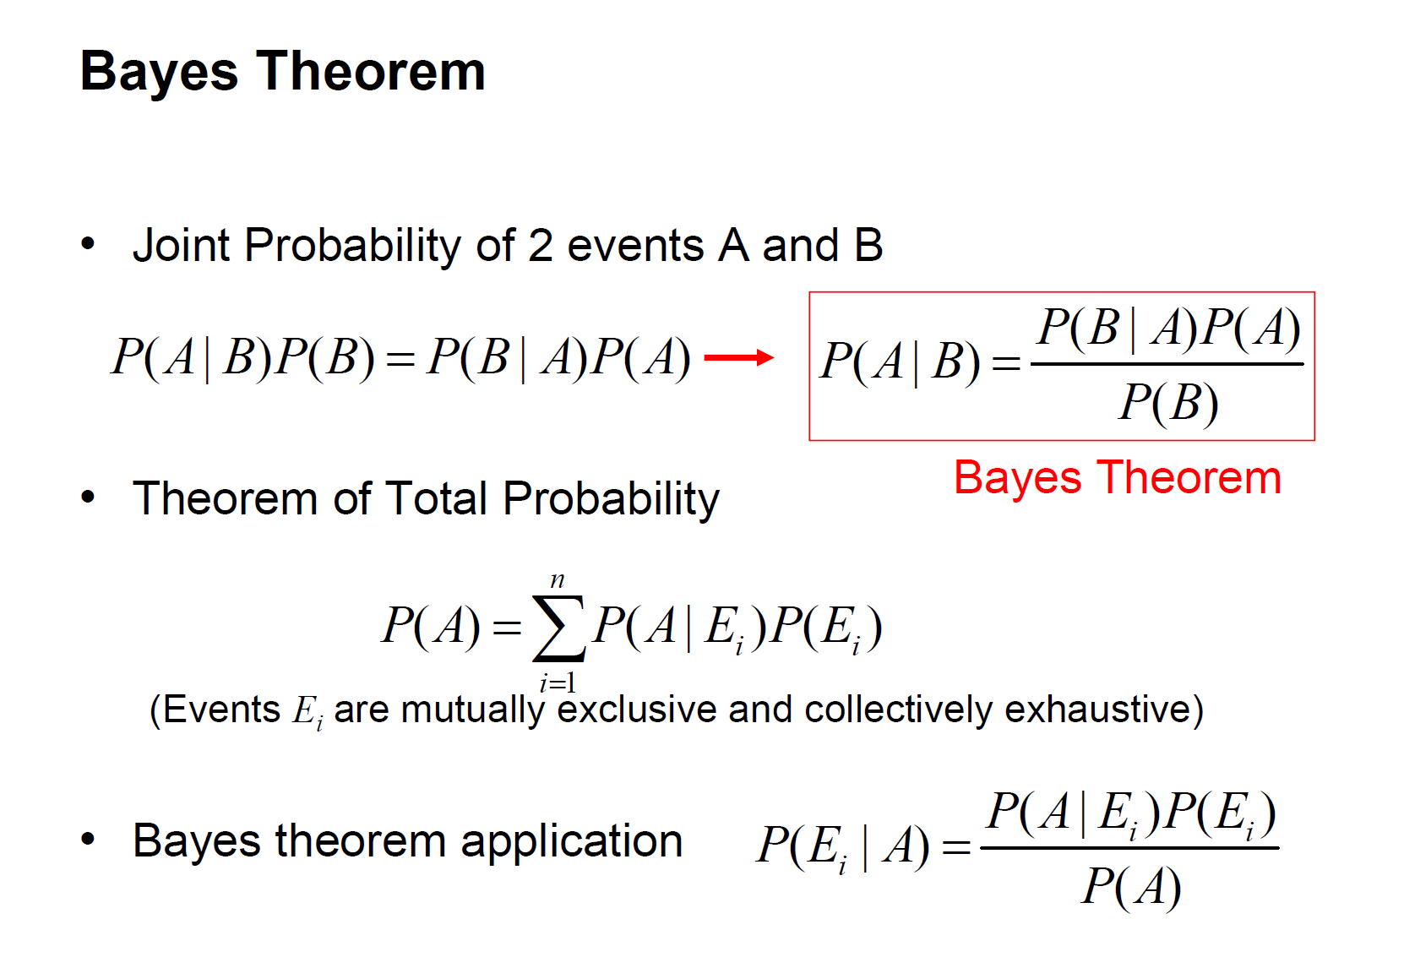

Slide 7
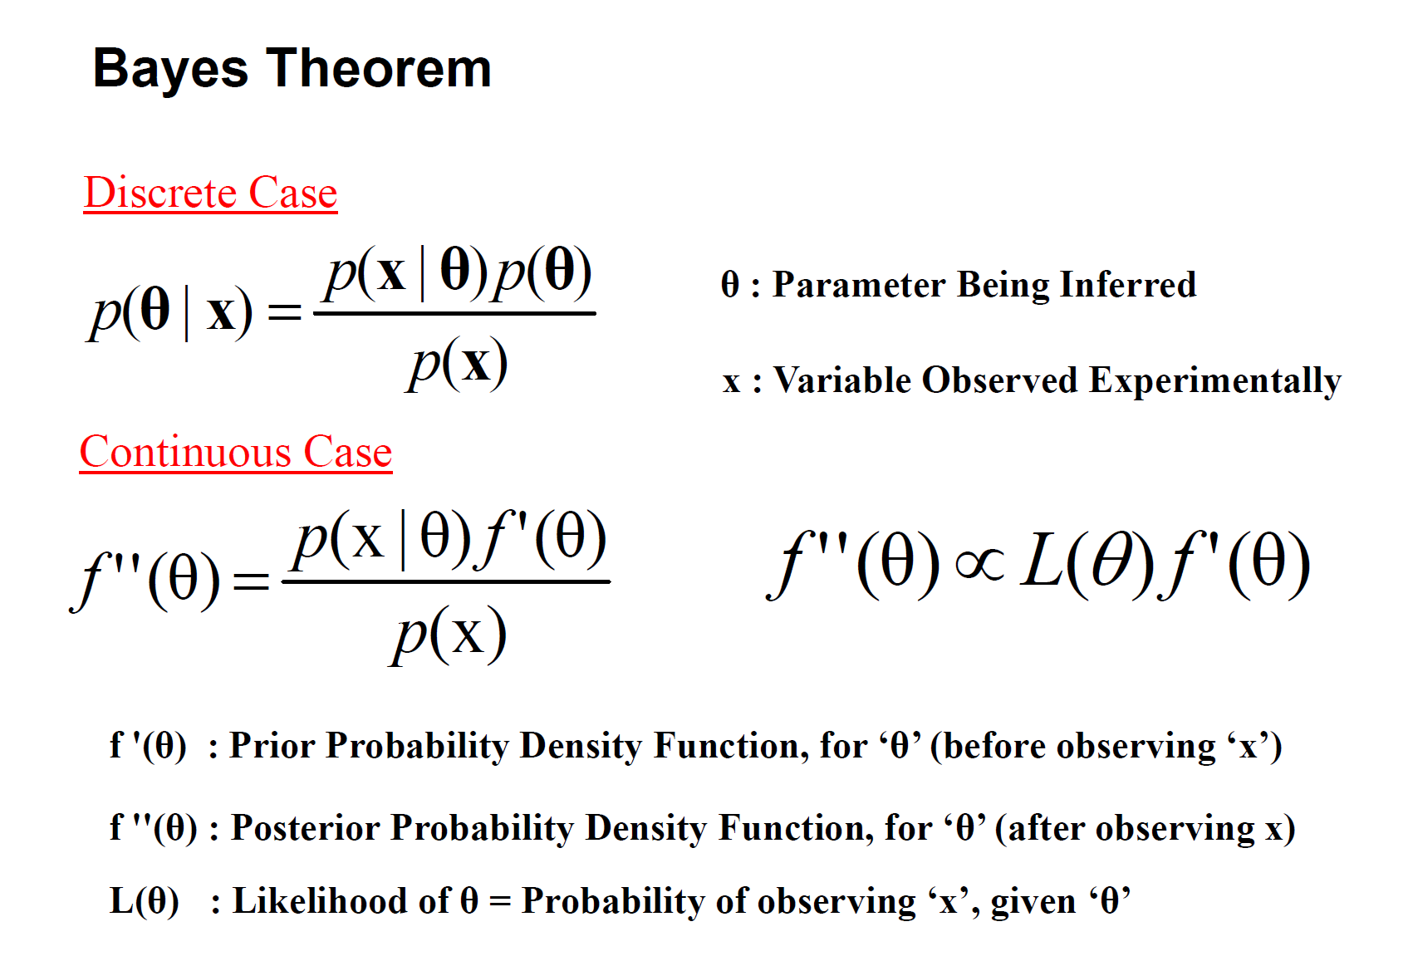

Slide 8
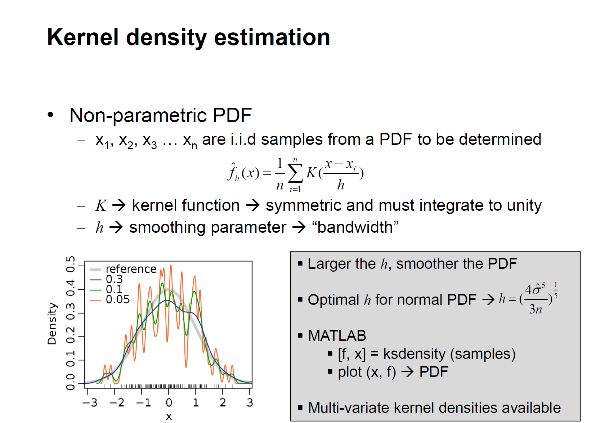

Slide 9
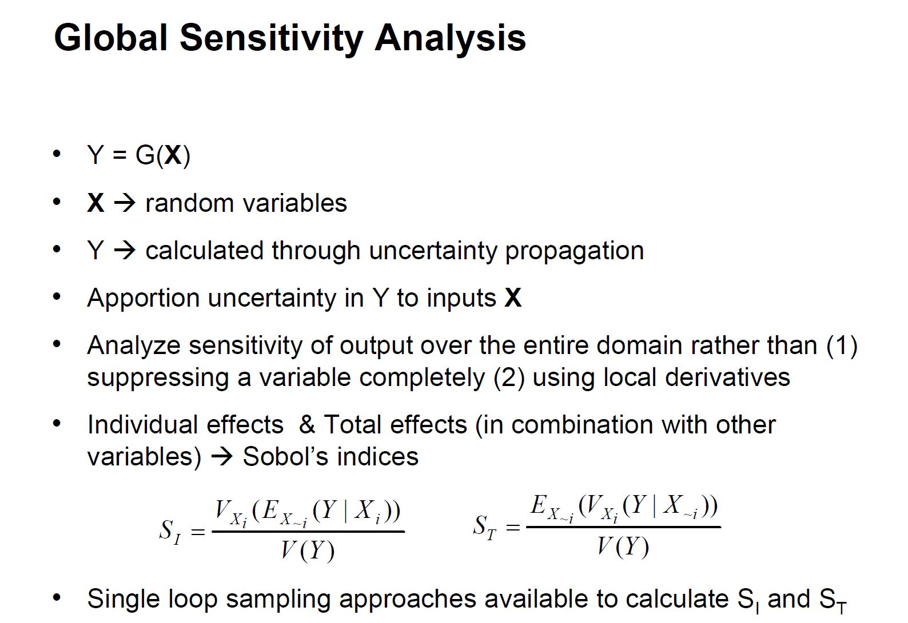

Slide 10
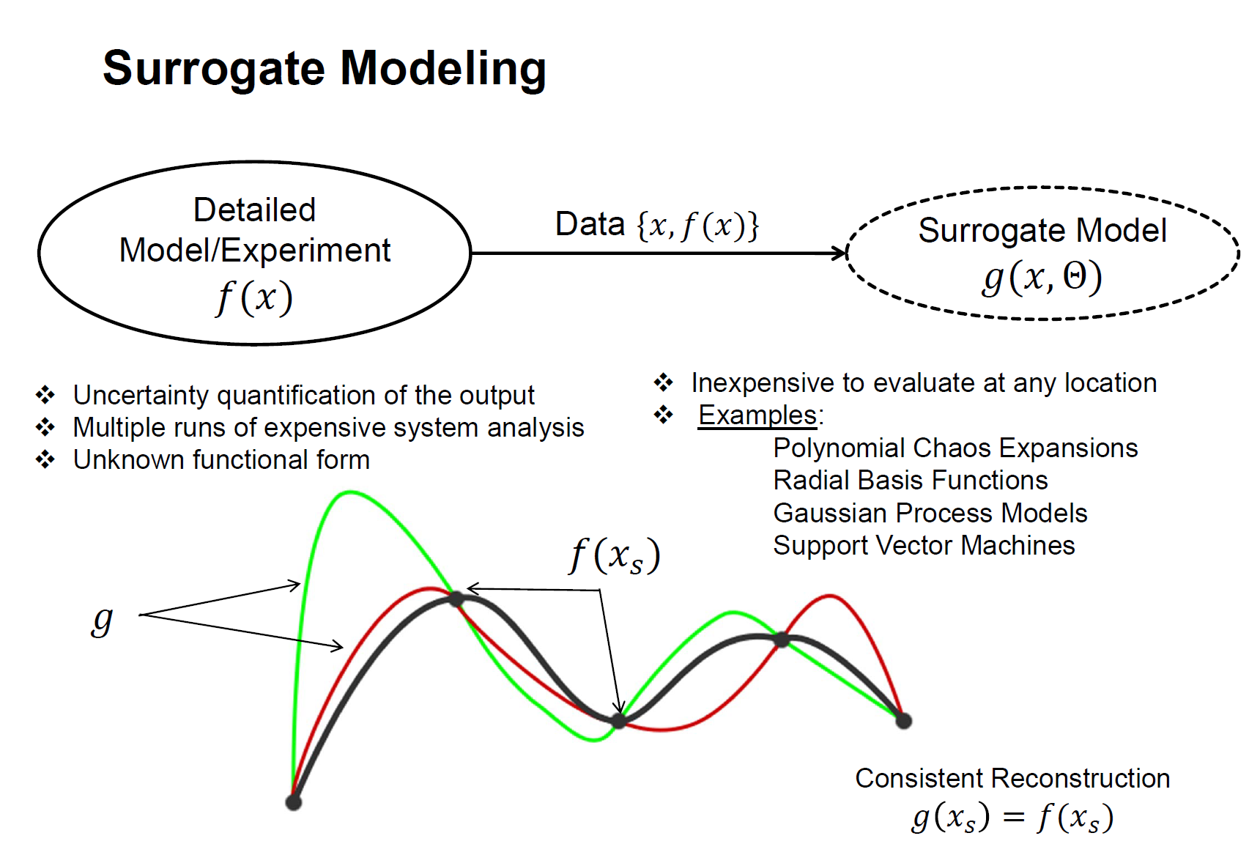

Slide 11
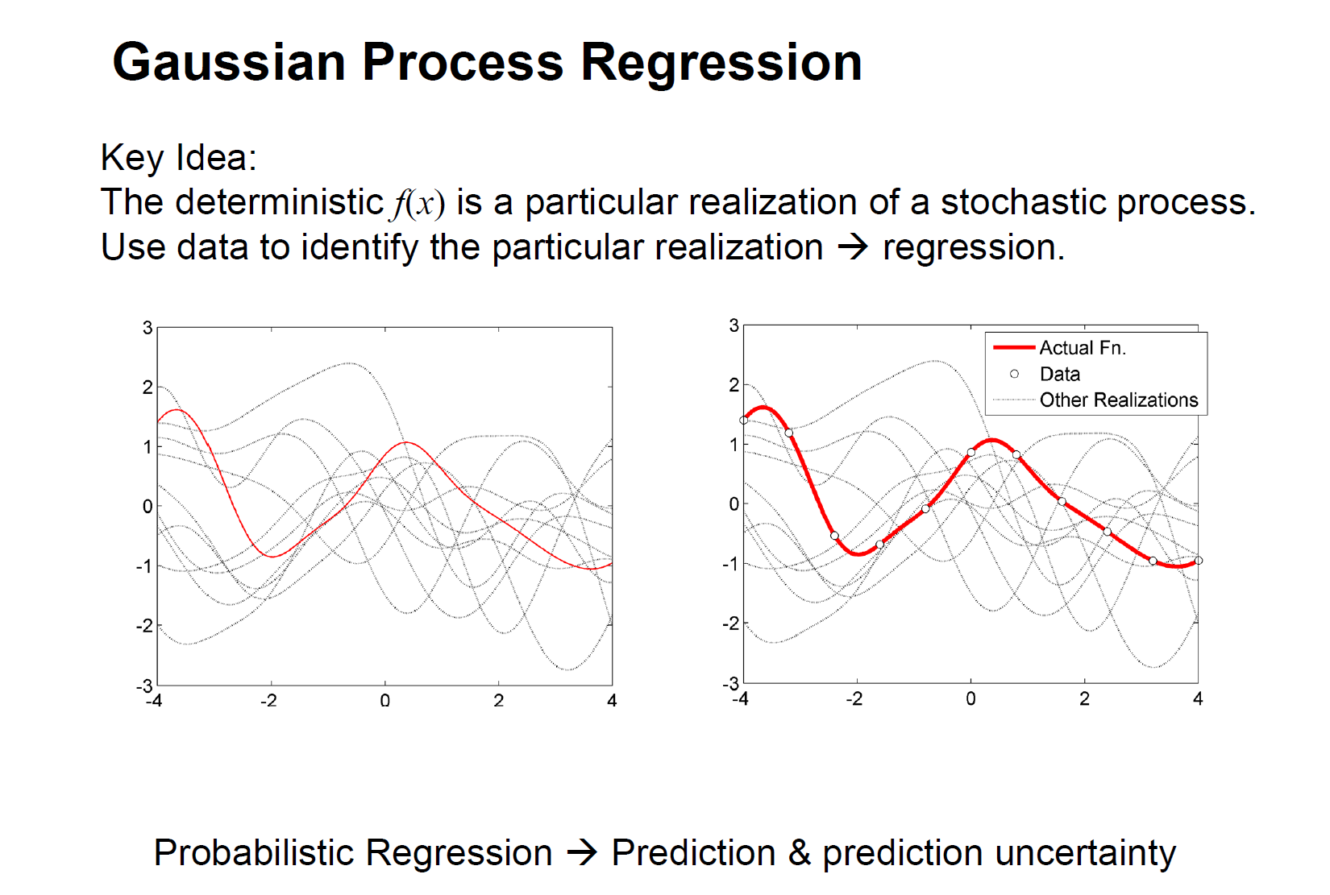

Slide 13
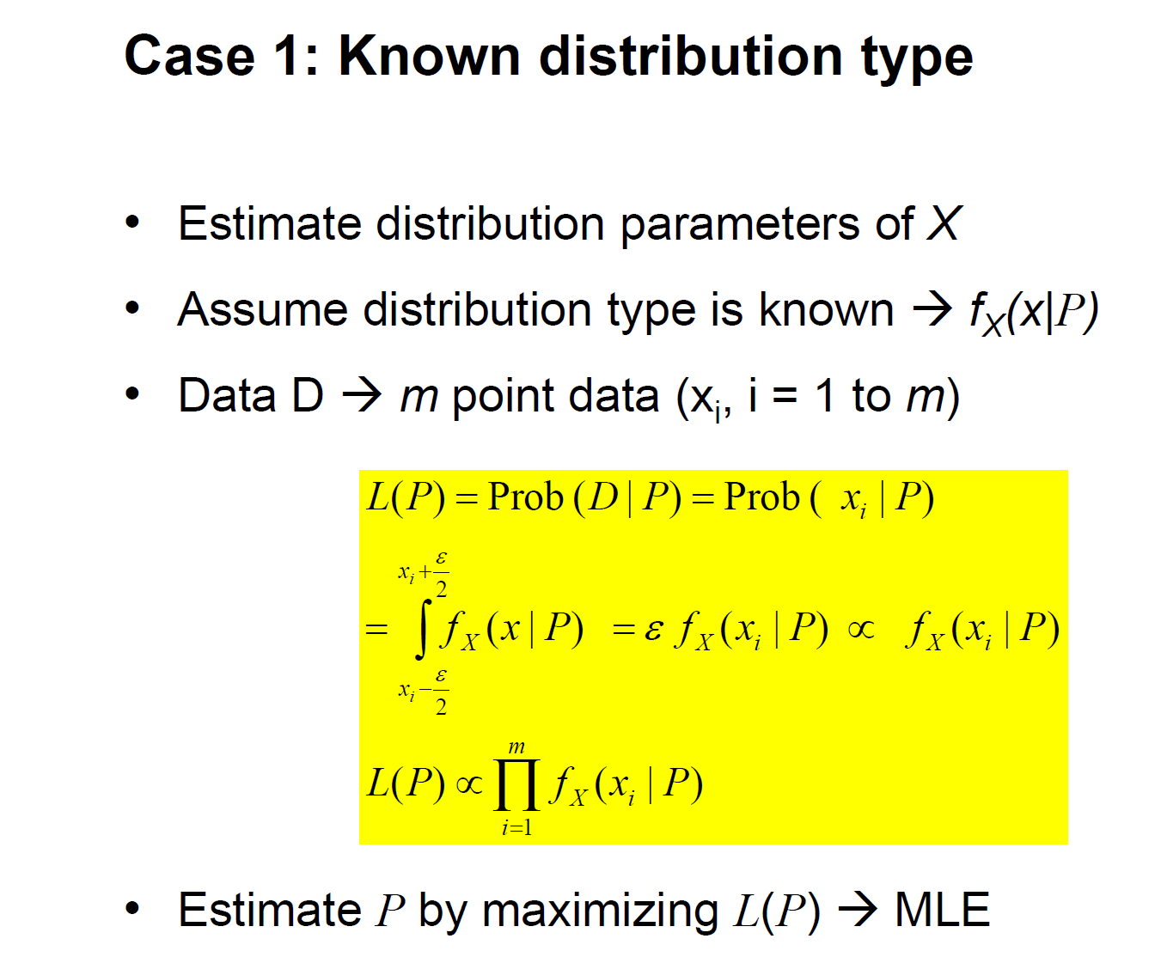
Likelihood-Based Approach to Data Uncertainty

Slide 14
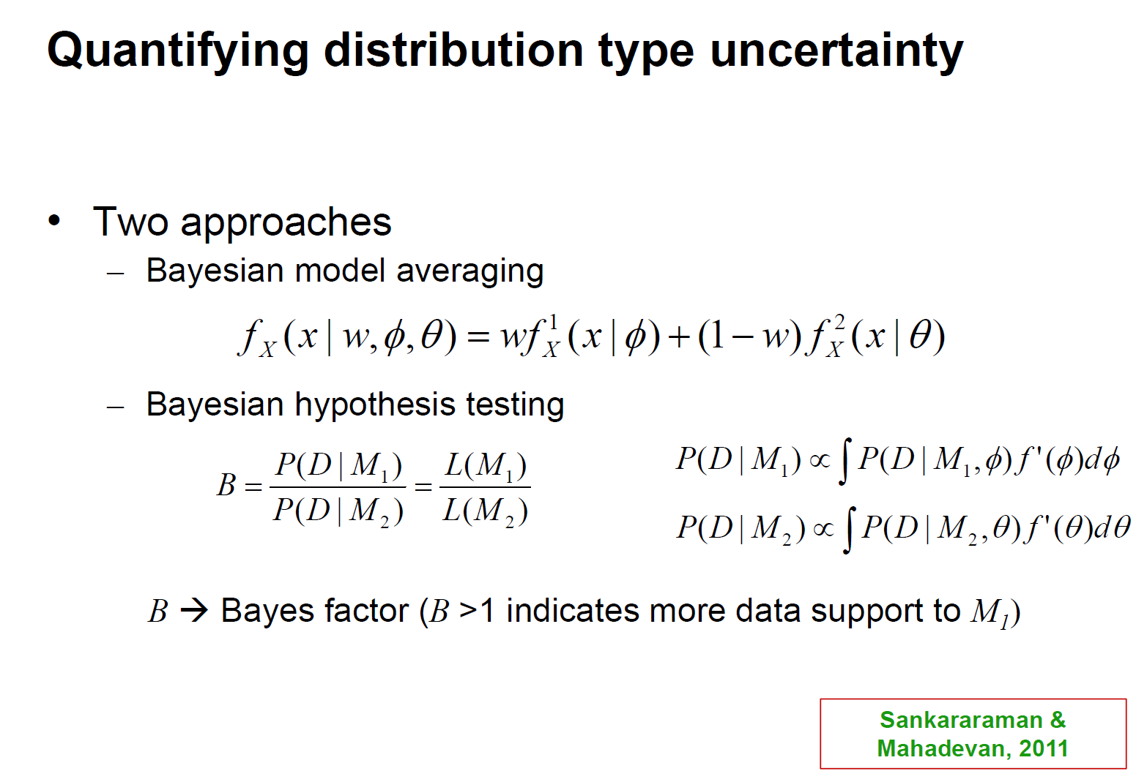

Slide 15
Model uncertainties
Model Calibration
Model Validation
Model Selection
Model Error Quantification

Slide 16
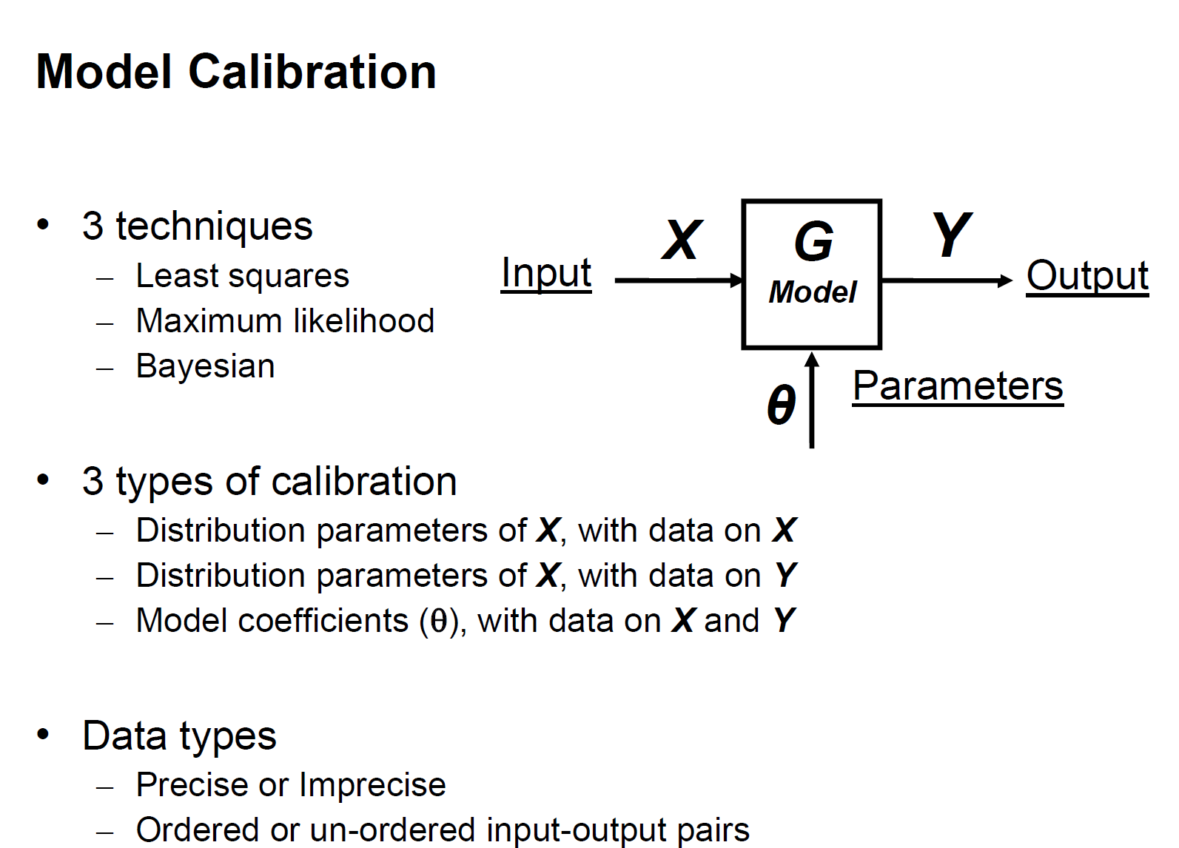

Slide 17
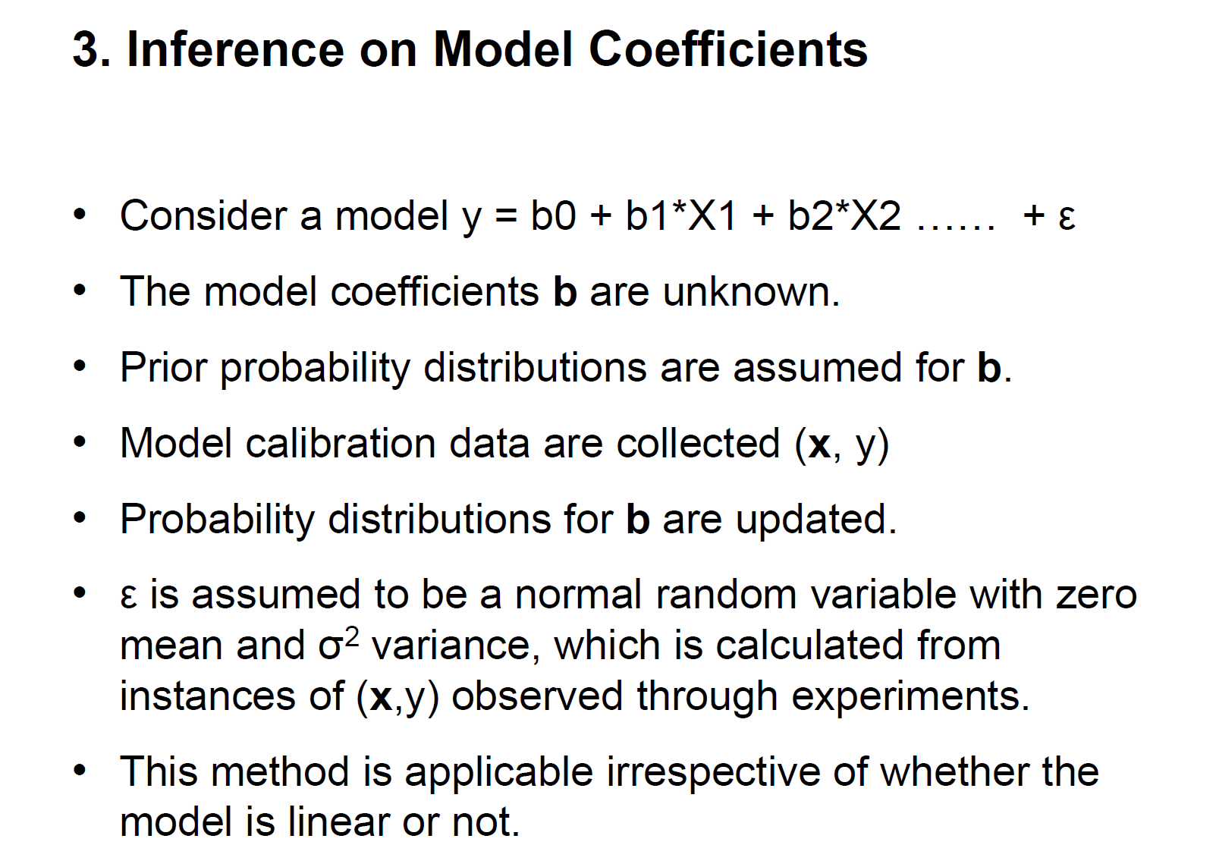

Slide 18
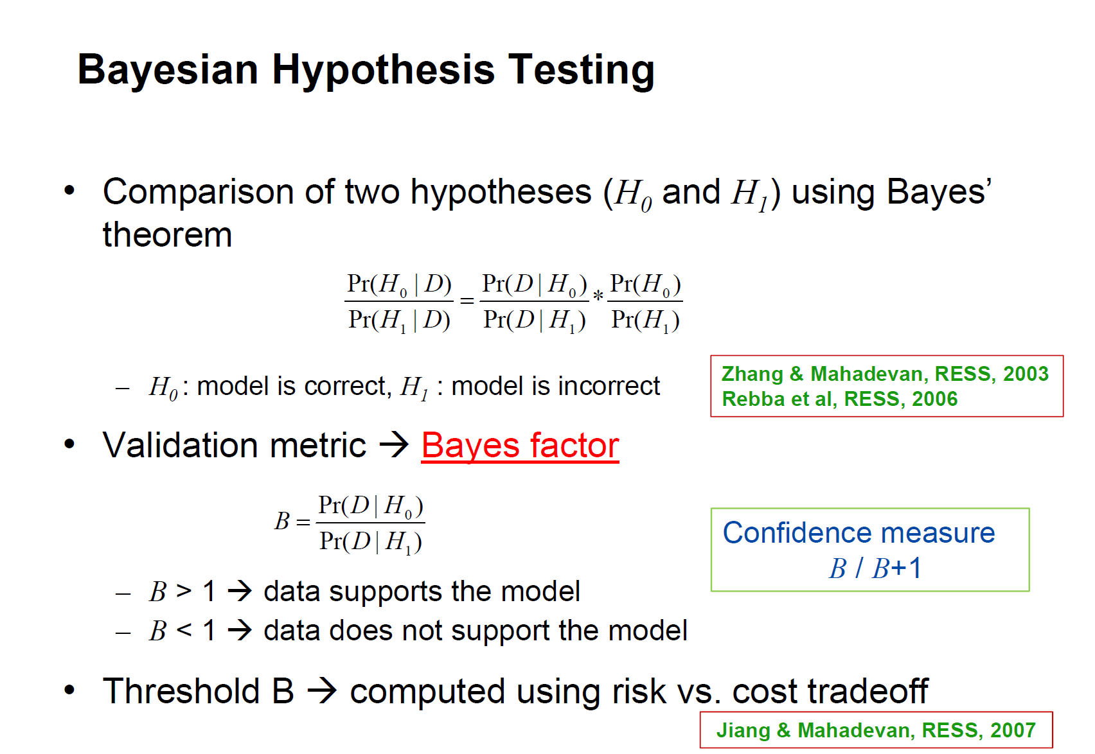
Model validation

Slide 19
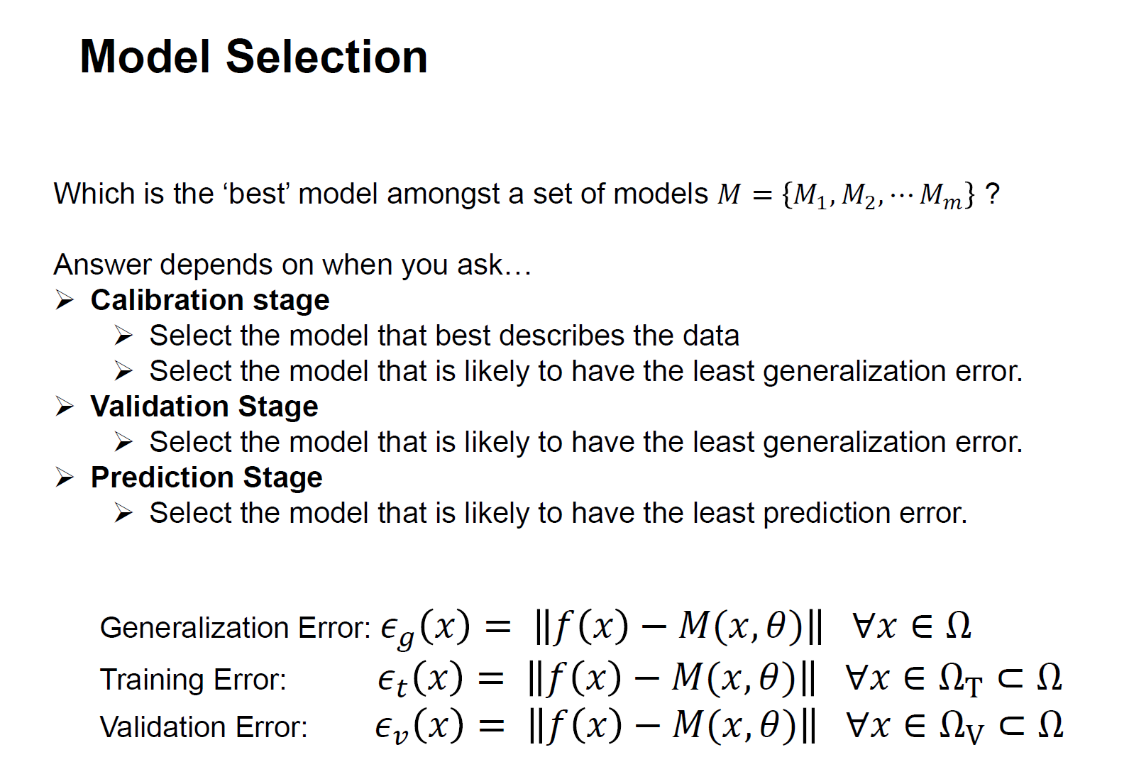

Slide 20
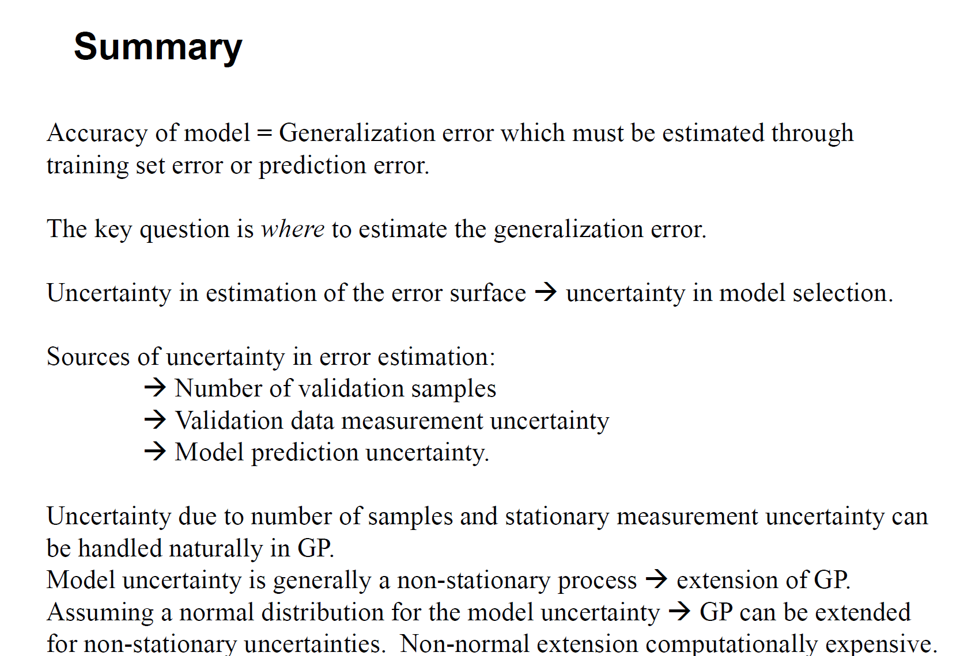

Slide 21
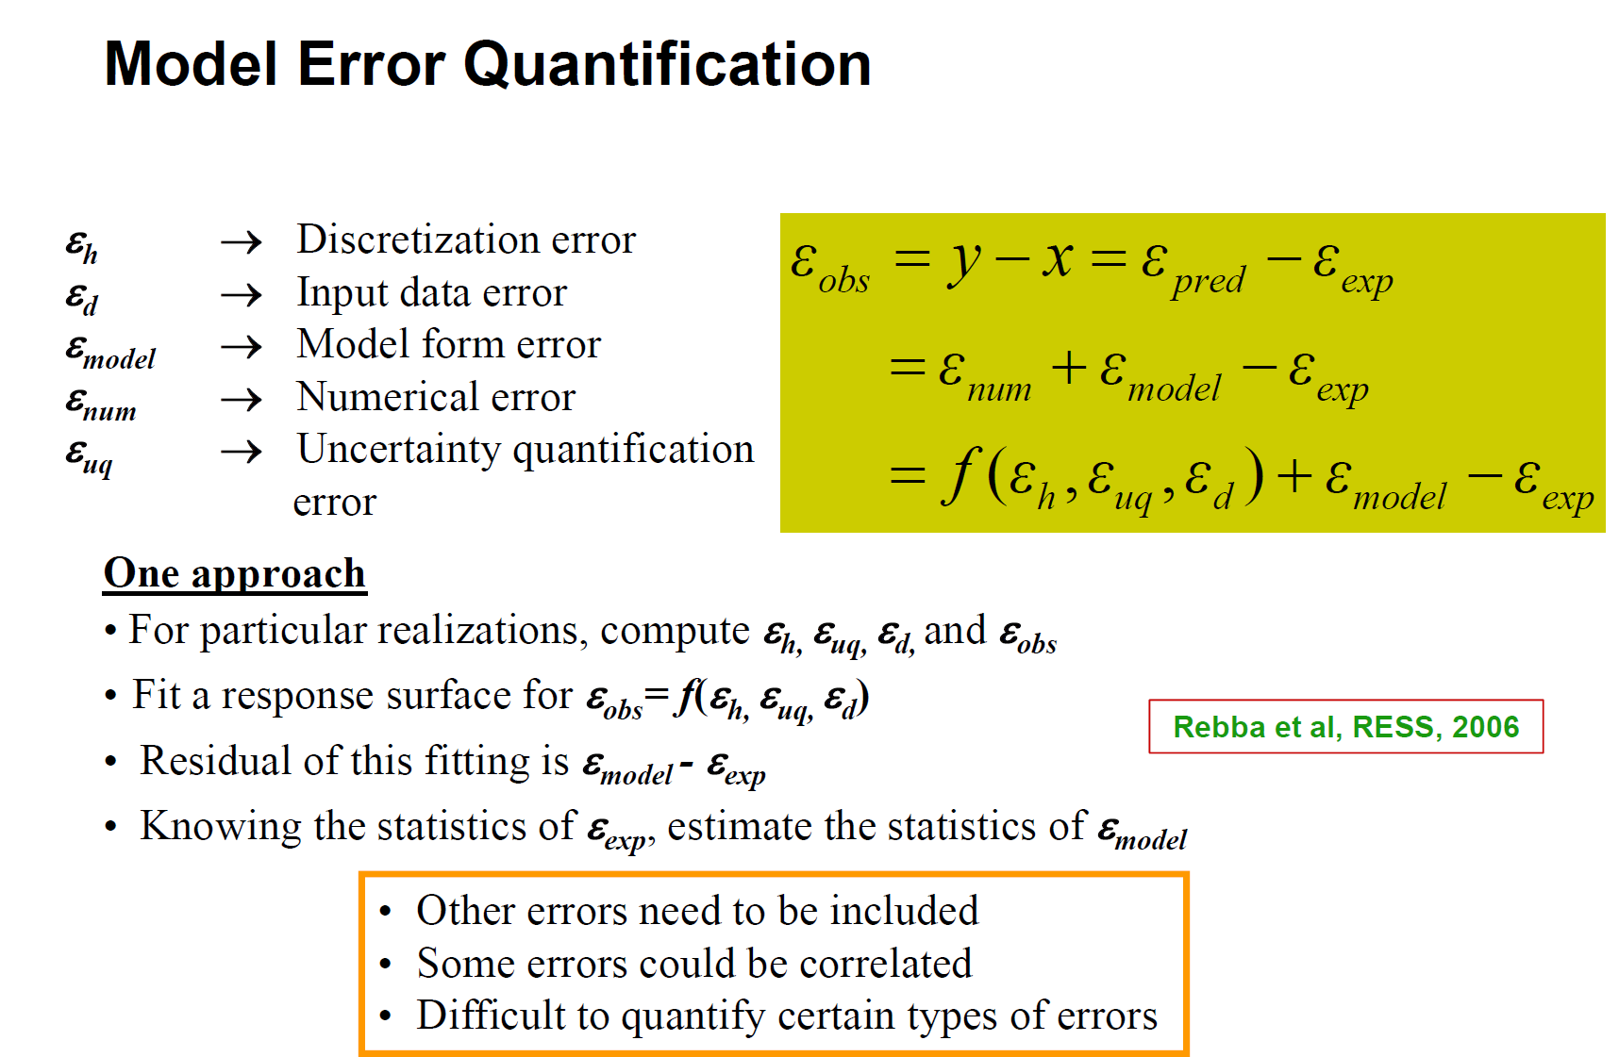

Slide 22
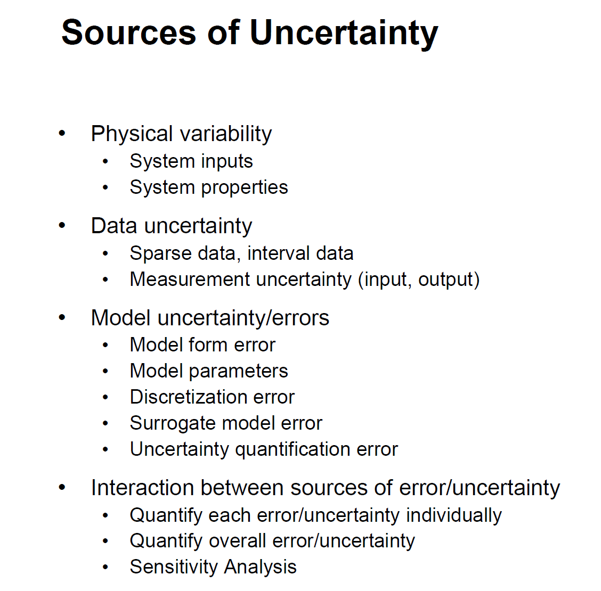

Slide 23
